Slide 1

Tag-Based Recommender System
by Xiao Xin Li (xli147)
Prepared as an assignment for CS410: Text Information Systems in Spring 2016

Slide 2
Overview
The Recommender System
Traditional Recommendation Methods: definition, pros, and cons
Collaborative Filtering
Content-based Recommendations
Knowledge-based systems
Hybrid Approaches
Enhance Recommender Systems with User Profiles
Research papers
Leveraging Tagging Systems with User Information
Research papers
Tutorial Conclusions
Acknowledgements

Slide 3
The Recommender System

Slide 4
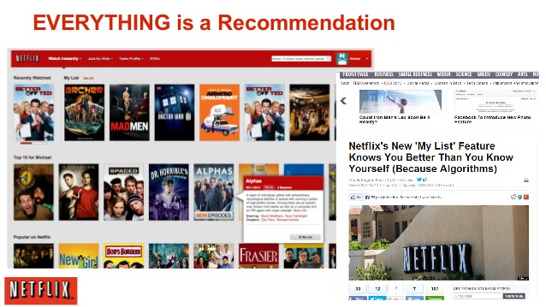
The Recommender System

Slide 5
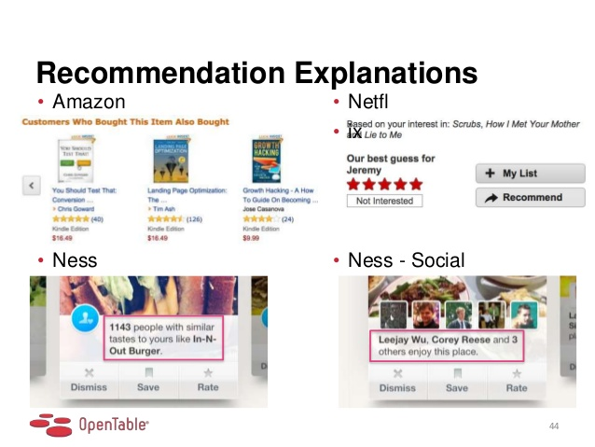
The Recommender System

Slide 6
The Recommender System
Traditional definition: Estimate a utility function that automatically predicts how a user will like an item.
Based on:
Past behavior
Relations to other users
Item similarity
Context
…

Slide 7
Traditional Recommendation Methods
Collaborative Filtering
Content-based Recommendations
Knowledge-based systems
Hybrid Approaches

Slide 8
Collaborative Filtering

Slide 9
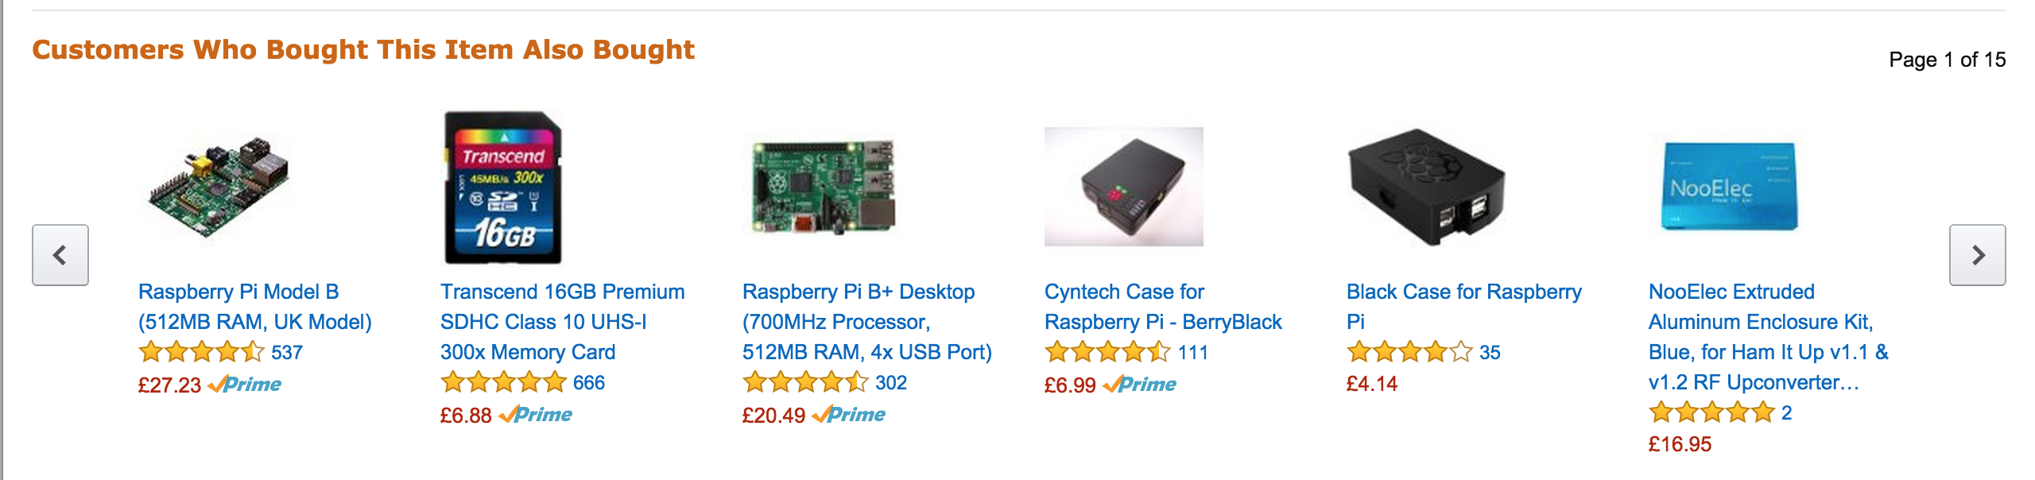
Collaborative Filtering
Widely used in e-commerce
Find users in a community that share the same interests in the past to predict what the current user will be interested in.
Notes:
User-based:
Recommendations are given to user based on evaluation of items by other users sharing common preferences
Item-based:
Predictions are calculated based on the similarity of ratings given by users for the items
More apt for offline preprocessing of large rating matrix

Slide 10
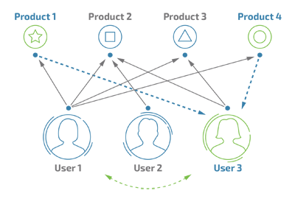
Collaborative Filtering
Notes:
This approach predicts the relevance of items for users based on user history, such as items previously purchased, viewed or liked by the visitor. The system compares one user’s history to others’ user journeys and based on this data, it creates a list of recommended items for the user. The collaborative filtering method suffers from the cold start problem, meaning that it cannot recommend items without historical data. They can be further classified into model-based and memory-based algorithms.

Slide 11
Algorithms
User-based nearest neighbor
Non-probabilistic Algorithms
Item-based nearest neighbor
Collaborative Filtering
Reducing dimensionality
Bayesian-network models
EM algorithm
Probabilistic Algorithms
Notes:
User-based:
Recommendations are given to user based on evaluation of items by other users sharing common preferences
Item-based:
Predictions are calculated based on the similarity of ratings given by users for the items
More apt for offline preprocessing of large rating matrix

Slide 12
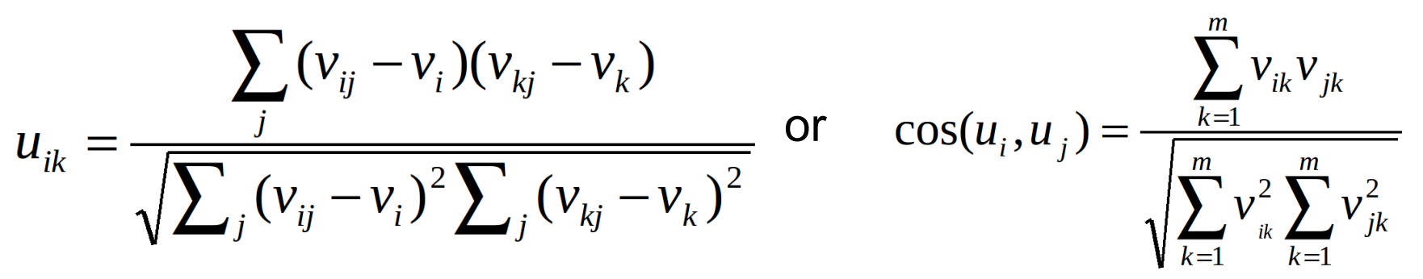
User-Based CF
A collection of user u_{i} , i=1, …, n and a collection of products p_{j} , j=1, …, m
An n × m matrix of ratings v_{ij} , with v_{ij} = ? if user i did not rate product j
Prediction for user i and product j is computed
Similarity can be computed by Pearson correlation

Slide 13
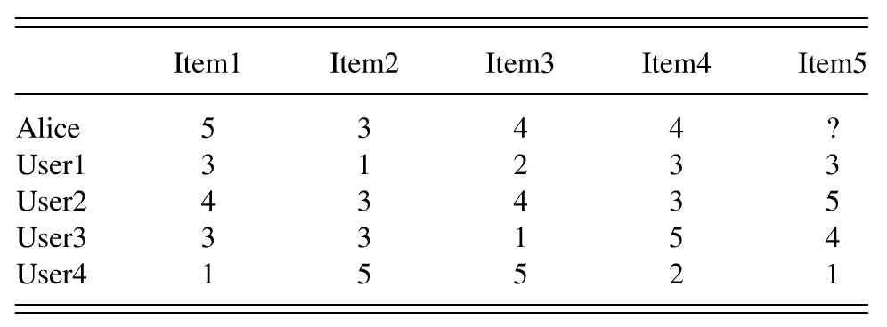
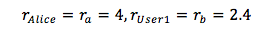
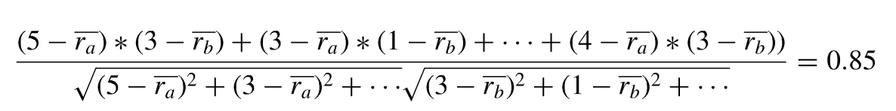
User-Based CF
The similarity of Alice to User1 is:

Slide 14
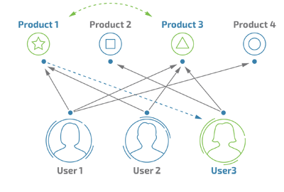
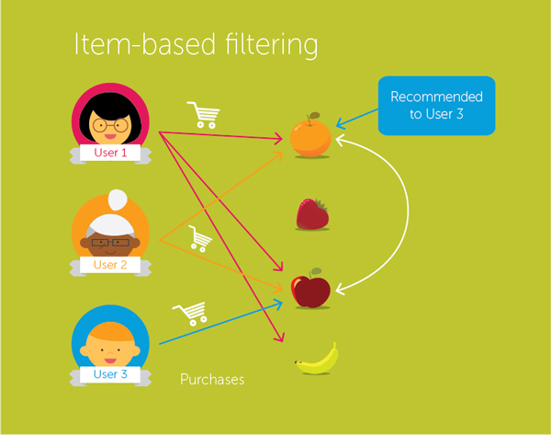
Item-Based CF

Slide 15
Item-Based CF
Look into the items the target user has rated
Compute how similar they are to the target item
Similarity only using past ratings from other users
Select k most similar items
Compute Prediction by taking weighted average on the target user’s ratings on the most similar items

Slide 16
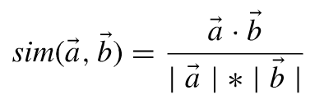
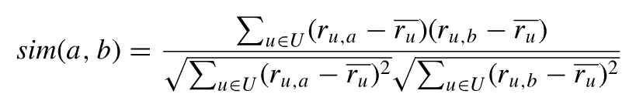
Item Similarity Computation
Cosine-based Similarity (difference in rating scale between users is not taken into account)
Adjusted Cosine Similarity (takes care of difference in rating scale)
U = set of users that rated both items a and b

Slide 17
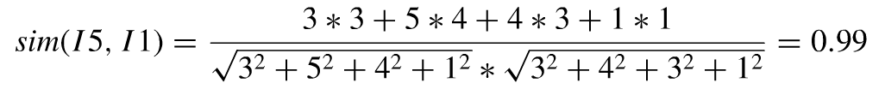
User-Based CF
The cosine similarity of Item5 and Item1 is:

Slide 18
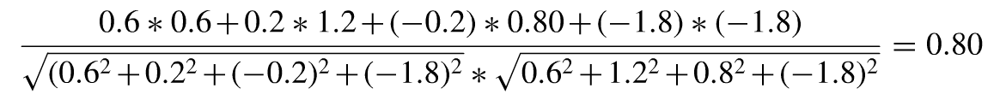
User-Based CF
The adjusted cosine similarity value for Item5 and Item1 is:

Slide 19
Memory-Based CF
Use the entire user-item database to generate a prediction
Usage of statistical techniques to find the neighbors – e.g. nearest-neighbor.

Slide 20
Model-Based CF
First develop a model of user
Type of model:
Probabilistic (e.g. Bayesian Network)
Clustering
Rule-based approaches (e.g. Association Rules)
Classification
Regression
LDA
…

Slide 21
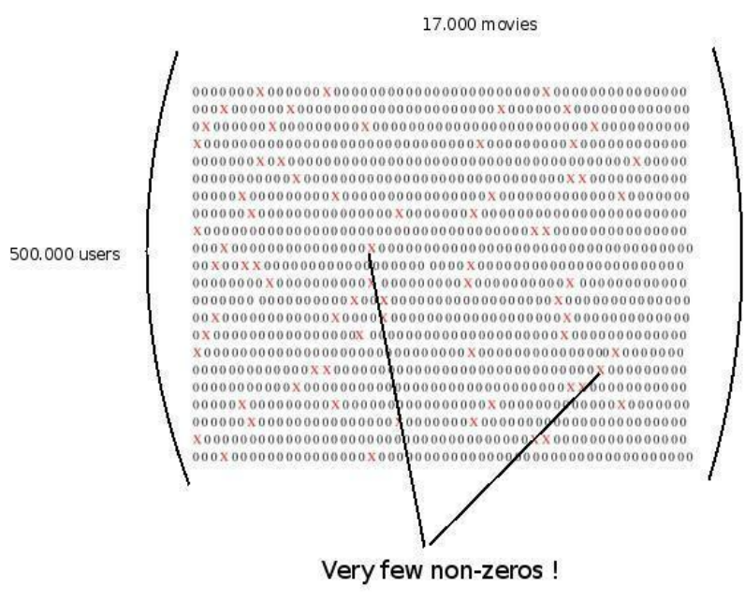
Pros & Cons
Pros:
Requires minimal knowledge engineering efforts
Users and products are symbols without any internal structure or characteristics
Produces good-enough results in most cases
Cons:
Sparsity – evaluation of large itemsets
where user/item interactions are under
1%
Scalability - Nearest neighbor require
computation that grows with both the
number of users and the number of
items

Slide 22
Content-Based Recommenders

Slide 23
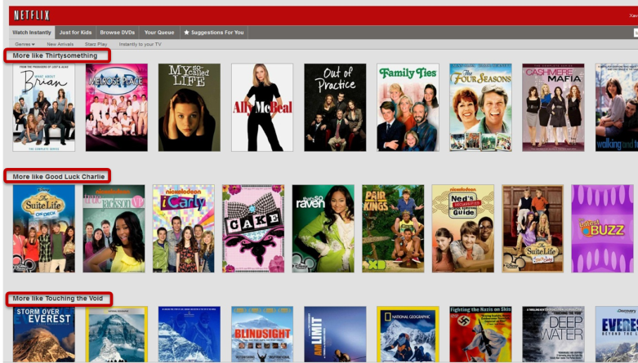
Content-Based Recommenders
Notes:
Content-based filtering (CBF) algorithms recommend items whose metadata are similar to the metadata of items the user has interacted with in the past. For instance, in the case of product recommendations, the product description, category, price, physical parameters, etc. are content metadata. Unlike the collaborative filtering approach, CBF does not suffer from new-item and cold-start problems.

Slide 24
Content-Based Recommenders
Recommendations based on content of items rather than on other users’ opinions/interactions
Common for recommending text-based products
Notes:
Goal: recommend items similar to those the user liked

Slide 25
Similarity-Based Retrieval
Nearest Neighbors
Relevance Feedback and Rocchio’s Algorithm
Probabilistic approaches based on Naïve Bayes
Linear classiﬁers and machine learning
Decision Tree

Slide 26
How they work?
Items to recommend are “described” by their associated features (e.g. keywords)
User Model structured in a “similar” way as the content: features/keywords more likely to occur in the preferred documents (lazy approach)
The user model can be a classifier based on whatever technique (Neural Networks, Naïve Bayes...)

Slide 27
Pros & Cons
Pros
User independence
No cold-start or sparsity
Able to recommend to users with unique tastes
Able to recommend new and unpopular items
Can provide explanations by listing content-features
Cons
Requires content that can be encoded as meaningful features (difficult in some domains/catalogs)
Users represented as learnable function of content features
Difficult to implement serendipity
Easy to overfit (e.g. for a user with few data points)

Slide 28
CF vs. CB
 | CF | CB
Compare | Users interest | Item info
Similarity | Set of users User profile | Item info Text document
Shortcoming | Other users’ feedback matters Coverage Unusual interest | Feature matters Over-specialize Eliciting user feedback

Slide 29
Knowledge-based systems

Slide 30
Knowledge-Based Systems

Slide 31
Knowledge-Based Systems
Select items from the catalog that fulfill a set of applicable constraints specified by the user
Two basic types:
Constraint-based
Case-based

Slide 32
Pseudocode
Users specify the requirements
Systems try to identify solutions
If no solution can be found, users change requirements

Slide 33
Constraint-Based vs. Case-Based
Case-based:
Based on different types of similarity measures
Retrieve items that are similar to specified requirements
Constraint-based:
Rely on explicitly defined set of rules
Retrieve items that fulfill the rules
Critiquing is an effective way to support navigation in item space to find useful alternatives

Slide 34
Pros & Cons
Pros
Cold-start problem doesn’t exist
recommendations are calculated independently of user ratings
Does not have to gather information about a particular user
Judgments are independent of individual tastes
Cons
High cost and effort
The nature of knowledge
Knowledge is specific to the domain
Can not be shared without the presence of expert even the knowledge is available 
The level of risk
Development cost is very high
Cost goes higher and higher in maintaining these systems

Slide 35
Hybrid Approaches

Slide 36
Hybrid Recommender Systems: Survey and Experiments
Input
CF-Based Recommender
Combiner
Reco
Input
Content-Based Recommender

Slide 37
Hybrid Recommender Systems: Survey and Experiments
Well-known survey of the design space of different hybrid recommendation algorithms by Robin Burke
Proposes a taxonomy of different classes of recommendation algorithms
Seven different hybridization strategies can be abstracted into three base designs:
Monolithic hybrids
Parallelized hybrids
Pipelined hybrids

Slide 38
Monolithic
Incorporates aspects of several recommendation strategies in one algorithm implementation
Data-specific preprocessing steps are used to transform the input data into a representation that can be exploited by a specific algorithm paradigm
Advantageous if little additional knowledge is available for inclusion on the feature level

Slide 39
Monolithic
Feature combination hybrid
uses a diverse range of input data
Feature augmentation hybrid
integrate several recommendation algorithms

Slide 40
Parallelized
Employ several recommenders side by side and employ a specific hybridization mechanism to aggregate their outputs
Least invasive to existing implementations
Act as an additional post-processing step

Slide 41
Parallelized
Mixed
combines the results of different recommender systems at the level of the user interface
results from different techniques are presented together.
Weighted
combines the recommendations of two or more recommendation systems by computing weighted sums of their scores.
Switching
require an oracle that decides which recommender should be used in a specific situation, depending on the user profile and/or the quality of recommendation results.

Slide 42
Pipelined
Implement a staged process in which several techniques sequentially build one another before the final one produces recommendations for the user
Most ambitious hybridization designs
Require deeper insight into algorithm’s functioning to ensure efficient runtime computations

Slide 43
Pipelined
Cascade hybrids
based on a sequenced order of techniques
each succeeding recommender only refines the recommendations of its predecessor
Meta-level hybridization design
one recommender builds a model that is exploited by the principal recommender to make recommendations

Slide 44
Summary
Collaborative Filtering
Content-based
Knowledge-based
Hybrid
User-Based CF
Similarity-Based Retrieval
Constraint-base
Monolithic
Item-Based CF
Case-Based
Parallelized
Memory-Based CF
Pipelined
Model-Based CF

Slide 45
Enhance Recommender Systems with User Profiles

Slide 46
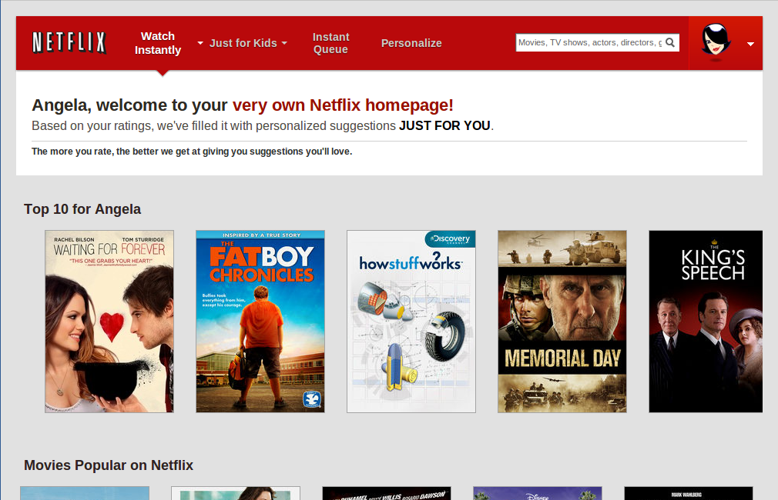
Recommendations Just For You

Slide 47
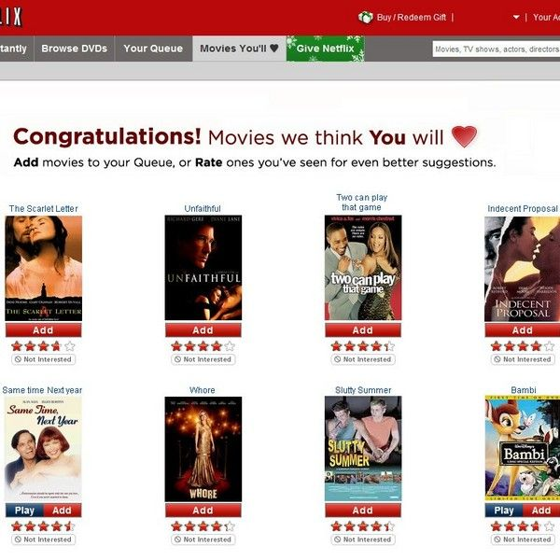
Personalized Recommendations

Slide 48
Why Using User Profile?
A profile of the user's interests is used by most recommendation systems
Used to provide personalized recommendations
Describes the types of items the user likes
Compares items to the user profile to determine what to recommend
Created and updated automatically in response to feedback on the desirability of items that have been presented to the user

Slide 49
Accounting for Taste: Using Profile Similarity to Improve Recommender Systems
Philip Bonhard , Clare Harries , John McCarthy , M. Angela S

Slide 50
Background
User-user collaborative filtering comes closest to emulating real world recommendations
based on user rather than item matching
Recommender system research focus:
Precision effectiveness: tested against the real ratings
Prediction efficiency: computational cost in terms of time and resources for calculating predictions
Recommender systems can be made more effective and usable by appropriating some functionality from social systems
Philip Bonhard , Clare Harries , John McCarthy , M. Angela Sasse, Accounting for taste: using profile similarity to improve recommender systems

Slide 51
Experiment
Independent variables: recommender profile characteristics
familiarity, profile similarity, and rating overlap
Dependent variable: choices people make in a recommender system context
Hypotheses and results:
Familiar recommenders will be preferred
not supported
Similar recommenders will be preferred
overwhelmingly supported
Recommenders with high rating overlap will be preferred
supported
Philip Bonhard , Clare Harries , John McCarthy , M. Angela Sasse, Accounting for taste: using profile similarity to improve recommender systems

Slide 52
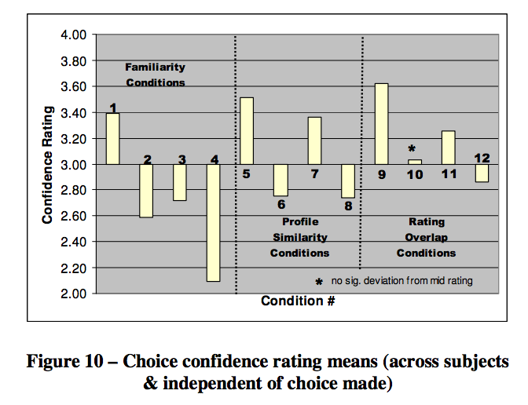
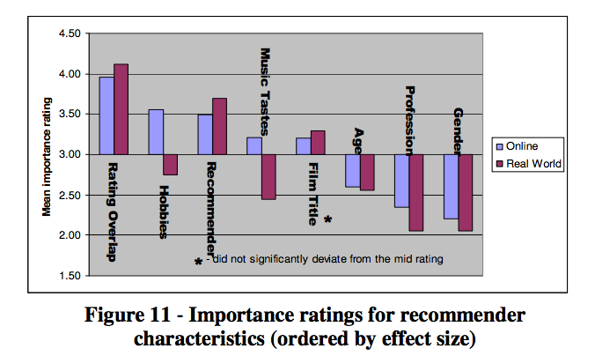
Results
Philip Bonhard , Clare Harries , John McCarthy , M. Angela Sasse, Accounting for taste: using profile similarity to improve recommender systems

Slide 53
Conclusions
Rating overlap in combination with profile similarity can be a powerful source of information for a decision-maker when judging the validity of a recommendation
Participants were more confident in their choices when the recommender had a high rating overlap with them in combination with a similar profile
Decision-makers trust recommenders more when they have high rating overlap and a similar profile
Philip Bonhard , Clare Harries , John McCarthy , M. Angela Sasse, Accounting for taste: using profile similarity to improve recommender systems

Slide 54
Leveraging Tagging Systems with User Information

Slide 55
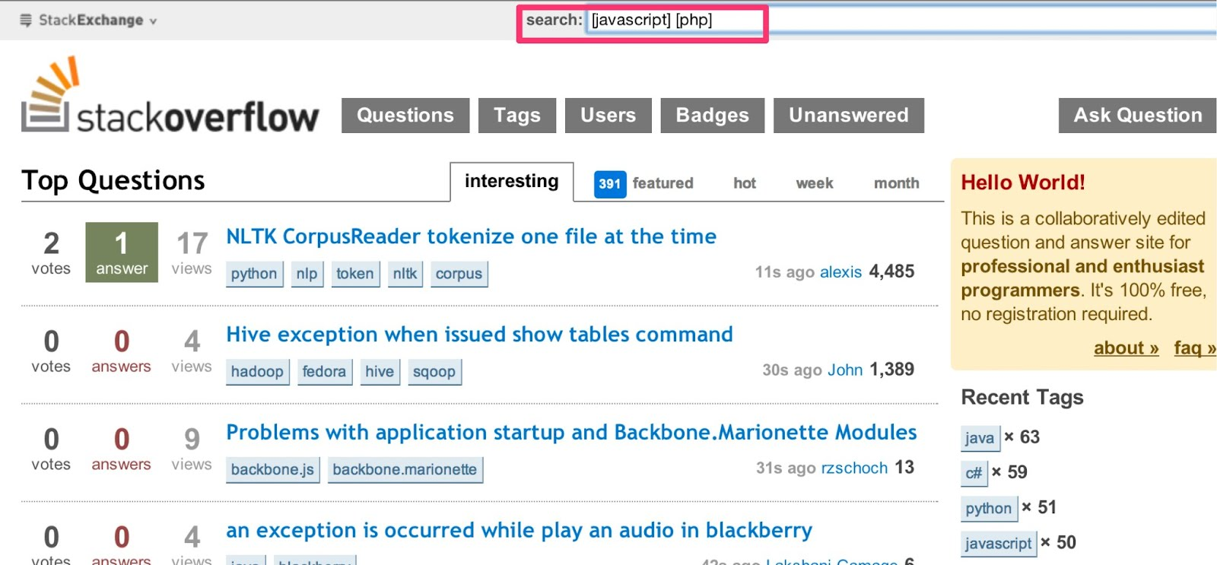
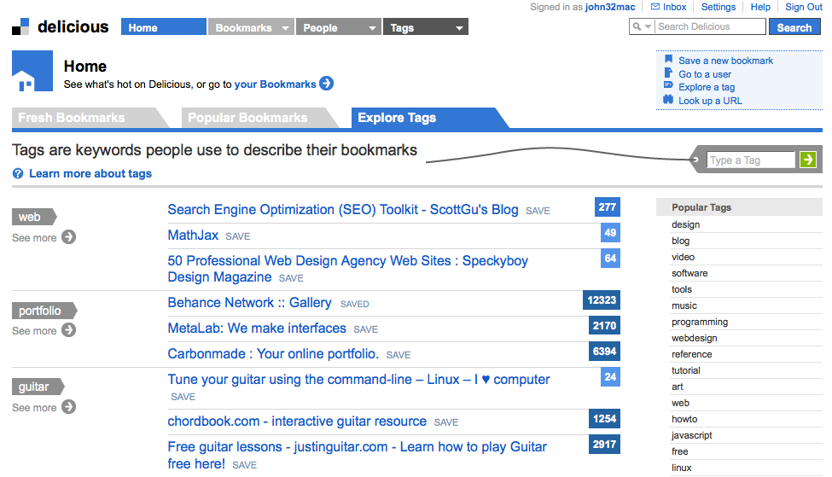
Tagging Recommender System

Slide 56
Tagging
The process of assigning metadata in the form of keywords to shared content by many users
An important way to provide information about resources on the Web
Enable the organization of information within personal information spaces that can be shared

Slide 57
Collaborative Tagging Systems
Folksonomies
Allow users to tag documents, share their tags, and search for documents based on these tags
Collaborative tagging
tagging of a collection of documents commonly accessible to a large group
Social bookmarking
tagging contents located all over the Web

Slide 58
Tag Recommendation
Recommend relevant tags for an untagged user resource
Integrative models that leverage all three dimensions of a social annotation system (users, resources, tags) produce superior results
Various purposes:
Increase the chances of getting a resource annotated
Remind users what a resource is about
Lazy annotation
…

Slide 59
Benefits of Collaborative Tagging Systems
Lowers costs
no complicated, hierarchically organized nomenclature to learn
Respond quickly to changes and innovations in the way users categorize content
inherently open-ended
Allow a user to search for the content that the user has tagged using a personal vocabulary
Assist navigation by providing dynamic hyperlinks among tags, documents and users

Slide 60
Challenges of Collaborative Tagging Systems
Too much freedom of choice of tags
Polysemy: words having multiple related meanings
Synonymy: multiple words having the same or similar meanings
Challenges in support knowledge management activities in an organization
Challenges in identifying communities of common interest
Challenges in identifying information leaders or domain experts
Lack of a document hierarchy prevents it from being widely adopted by enterprises
Organizations need systematic mechanisms of storing and retrieving documents

Slide 61
A Personalized Recommender System Based on Users’ Information In Folksonomies
Mohamed Nader Jelassi, Sadok Ben Yahia, Engelbert Mephu Nguifo

Slide 62
Motivation
Success of social bookmarking sharing systems
Flickr, Bibsonomy, Youtube, etc.
The users of a folksonomy have different profiles and expectations depending on their motivations
Personalization provides solutions to help users solve the information overload issue
Mohamed Nader Jelassi, Sadok Ben Yahia, Engelbert Mephu Nguifo, A Personalized Recommender System Based on Users’ Information In Folksonomies

Slide 63
Personalized Recommendation in Folksonomies
Extend the folksonomy
Combine both shared tags/resources
quadratic concepts
bring maximal shared sets of users, tags and resources
Personalize tags/resources recommendations
Users’ profile as a new dimension
look for both users’ profile and tagging history before making recommendation
Mohamed Nader Jelassi, Sadok Ben Yahia, Engelbert Mephu Nguifo, A Personalized Recommender System Based on Users’ Information In Folksonomies

Slide 64
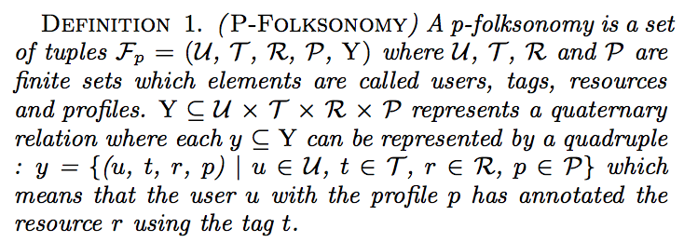
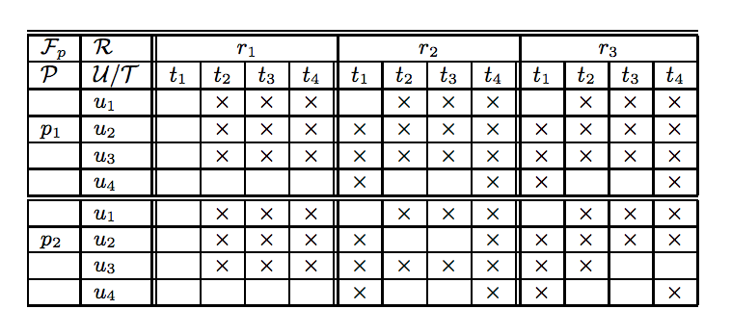
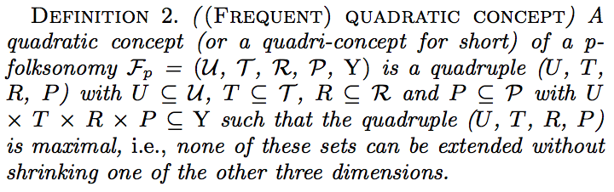
Quadratic Concepts
Mohamed Nader Jelassi, Sadok Ben Yahia, Engelbert Mephu Nguifo, A Personalized Recommender System Based on Users’ Information In Folksonomies

Slide 65
Steps
Inputs: a set of frequent quadri-concepts, a user u with its profile p and optionally a resource r to annotate
Outputs: a set of proposed users, suggested tags and recommended resources
User Proposition Step
seeks for quadri- concepts whose users have the same profile
Tag Suggestion Step
suggest personalized tags to a target user that share a resource in the p-folksonomy
Resource Recommendation Step
propose a personalized list of resources to a targeted user that is susceptible to be in accordance with its interests
Mohamed Nader Jelassi, Sadok Ben Yahia, Engelbert Mephu Nguifo, A Personalized Recommender System Based on Users’ Information In Folksonomies

Slide 66
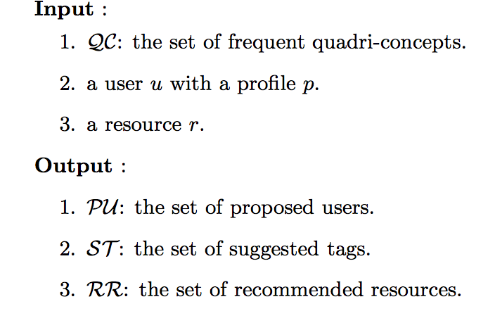
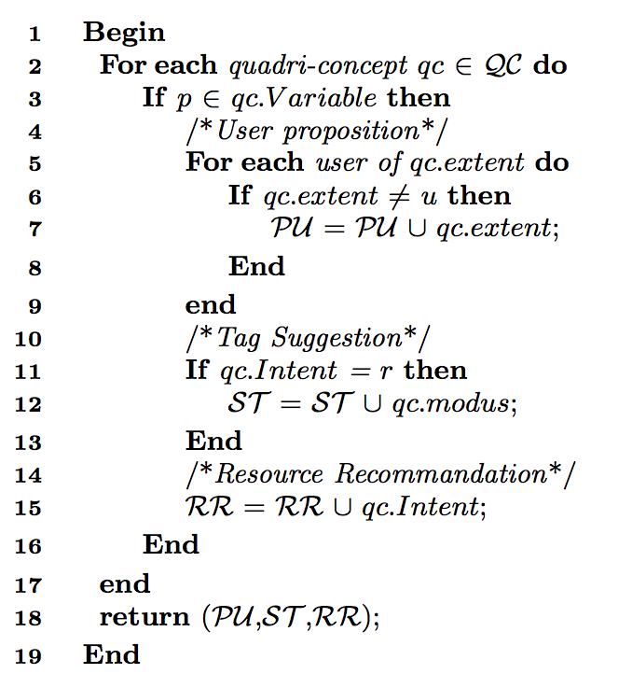
Algorithm
Mohamed Nader Jelassi, Sadok Ben Yahia, Engelbert Mephu Nguifo, A Personalized Recommender System Based on Users’ Information In Folksonomies

Slide 67
Evaluation
MovieLens dataset
with examples of extracted quadri-concepts following different profiles of folksonomy’ users
50,000 users
95,580 tags applied to 10,681 movies by 71,567 users
Additional user information available:
Gender, profession, age
Training set/Test set
80% as training set
20% as validation data
Mohamed Nader Jelassi, Sadok Ben Yahia, Engelbert Mephu Nguifo, A Personalized Recommender System Based on Users’ Information In Folksonomies

Slide 68
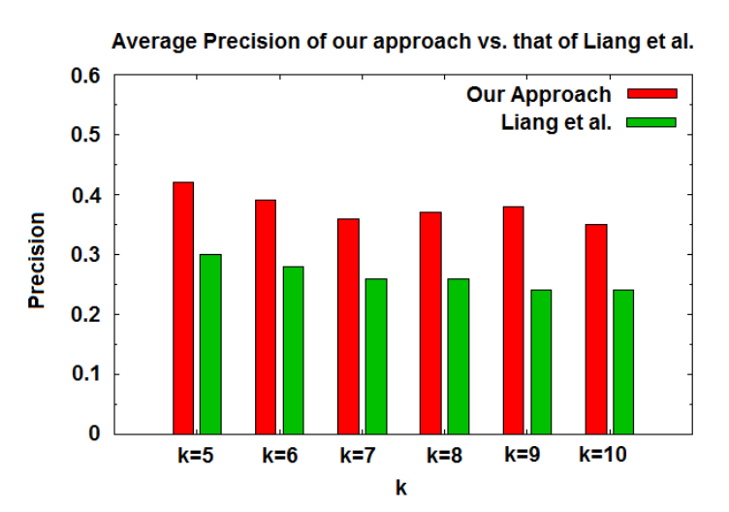
Results
Mohamed Nader Jelassi, Sadok Ben Yahia, Engelbert Mephu Nguifo, A Personalized Recommender System Based on Users’ Information In Folksonomies

Slide 69
Results and Conclusions
In an average of 38% outperforms the precision of the approach of Liang et al., which is between 24% and 30%
Best performances obtained with k=5
Quadratic concepts improves the recommendations by suggesting tags and resources the more specific to users’ needs
Mohamed Nader Jelassi, Sadok Ben Yahia, Engelbert Mephu Nguifo, A Personalized Recommender System Based on Users’ Information In Folksonomies

Slide 70
Hybrid tag recommendation for social annotation system
Jonathan Gemmell, Thomas Schimoler, Bamshad Mobasher, Robin Burke

Slide 71
Data Model
Record of a user labeling a resource with one or more tags
Collection of annotations results in a complex network of interrelated users, resources and tags
Social annotation system
Can be described as a four-tuple: U, R, T, A
Can be viewed as a three dimensional matrix: U, R, T
U: a set of users
R: a set of resources
T: a set of tags
A: a set of annotations
Jonathan Gemmell, Thomas Schimoler, Bamshad Mobasher, Robin Burke, Hybrid tag recommendation for social annotation system

Slide 72
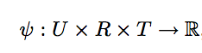
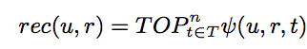
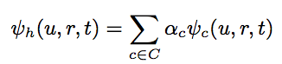
Linear Weighted Hybrid Tag Recommender
Aggregates the results of several component recommenders in linear combination
View each component of a tag recommendation system as a function
To produce a ranked list of suggested tags for a particular user given a specific resource:
Relevance score for a tag is calculated using several component tag recommenders
Jonathan Gemmell, Thomas Schimoler, Bamshad Mobasher, Robin Burke, Hybrid tag recommendation for social annotation system

Slide 73
Linear Weighted Hybrid Tag Recommender
Specializes in only a few available dimensions of the data
Focus on relatively simple component recommenders due to their speed and scrutability
Discussed components:
Popularity Models
User-Based Collaborative Filtering
Item-Based Collaborative Filtering
Jonathan Gemmell, Thomas Schimoler, Bamshad Mobasher, Robin Burke, Hybrid tag recommendation for social annotation system

Slide 74
Component 1: Popularity Models
Recommend the most popular tags
Strictly resource dependent
Does not take into account the tagging habits of the user
Serve as a baseline and may benefit the hybrid
Require little online computation
Easily built offline and can be incrementally updated
Jonathan Gemmell, Thomas Schimoler, Bamshad Mobasher, Robin Burke, Hybrid tag recommendation for social annotation system

Slide 75
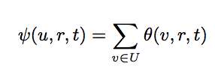
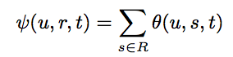
Component 1: Popularity Models
Resource based popularity recommender
User based popularity recommender
Jonathan Gemmell, Thomas Schimoler, Bamshad Mobasher, Robin Burke, Hybrid tag recommendation for social annotation system

Slide 76
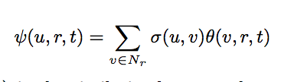
Component 2: User-based CF
Works under the assumption that users who have agreed in the past are likely to agree in the future
Relies on the collaboration of other users
Only recommends tags applied to the query resource
Narrows the focus of the recommendation regardless of the diversity in the user profile
Advantages:
Personalization
Disadvantages:
Cannot recommend tags that do not appear in a neighbor’s profile
Lacks the ability to reflect the habits and patterns of the larger crowd
Jonathan Gemmell, Thomas Schimoler, Bamshad Mobasher, Robin Burke, Hybrid tag recommendation for social annotation system

Slide 77
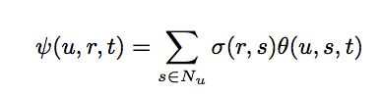
Component 3: Item-Based CF
Relies on discovering similarities among resources rather than among users
Similarity metrics only calculated with resources in the user profile
Constructs a neighborhood of resources from the user profile most similar to the query resource
Effectively ignores parts of the user profile not relevant to the recommendation task
Advantages:
Computation can be quickly done in real time
Similarities can be calculated offline for large user profile
Jonathan Gemmell, Thomas Schimoler, Bamshad Mobasher, Robin Burke, Hybrid tag recommendation for social annotation system

Slide 78
Evaluation
Datasets
Bibsonomy, Citeulike, MovieLens, Delicious, Amazon, LastFM
Methodology
Each user’s annotations were divided equally among five folds
The recommenders are evaluated on their ability to recommend tags given a user-resource pair
Evaluate returned tags against the tags in the holdout annotation
Jonathan Gemmell, Thomas Schimoler, Bamshad Mobasher, Robin Burke, Hybrid tag recommendation for social annotation system

Slide 79
Results
Integrative approach can exploit multiple dimensions of the data
Hybrid outperforms a state-of-the-art model-based algorithm based on tensor factorization (PITF)
particularly when the user profiles are diverse
Social annotation systems vary in how users interact with the system
The differences between datasets make the performance of individual recommenders unpredictable
Jonathan Gemmell, Thomas Schimoler, Bamshad Mobasher, Robin Burke, Hybrid tag recommendation for social annotation system

Slide 80
Advantages of the Proposed Hybrid System
More efficient, scalable, extensible and explainable than PITF
The proposed linear weighted hybrid inherits the capacity to focus on specific aspects of the user profile
Constructed from simple yet fast components
Offers a highly scalable and easily updatable solution for tag recommendation
Jonathan Gemmell, Thomas Schimoler, Bamshad Mobasher, Robin Burke, Hybrid tag recommendation for social annotation system

Slide 81
The Benefit of Using Tag-Based Profiles
Claudiu S. Firan, Wolfgang Nejdl, Raluca Paiu

Slide 82
Motivation
Tags are used to enable the organization of information within personal information spaces that can also be shared
Tag distributions stabilize over time and can be used to improve search on the Web
Question: How tags can characterize the user and enable personalized recommendations?
Claudiu S. Firan, Wolfgang Nejdl, Raluca Paiu, The Benefit of Using Tag-Based Profiles

Slide 83
Experiment
Dataset: Last.fm
Crawled subset of the Last.fm website, including pages corresponding to tags, music tracks and user profiles
Used track-based and tag-based profiles to evaluate different algorithms for producing music recommendations
Track-based user profiles: collections of music tracks with associated preference scores, describing users’ musical tastes
Tag-based user profiles: collections of tags together with corresponding scores representing the user’s interest in each of these tags
Claudiu S. Firan, Wolfgang Nejdl, Raluca Paiu, The Benefit of Using Tag-Based Profiles

Slide 84
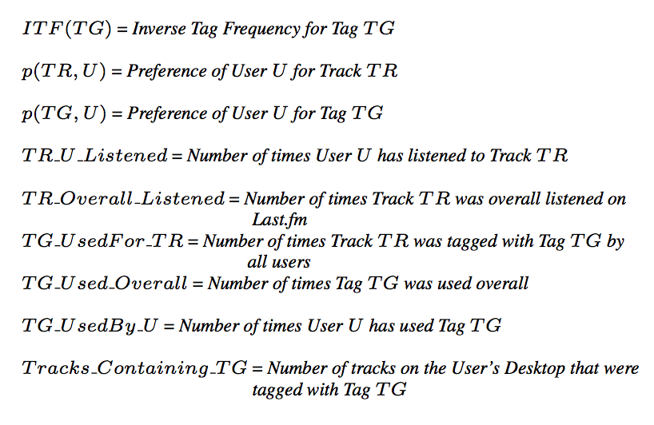
Notations
Claudiu S. Firan, Wolfgang Nejdl, Raluca Paiu, The Benefit of Using Tag-Based Profiles

Slide 85
Algorithms
7 algorithms based on the type of profile and the technique used for getting the recommendations
three categories:
Collaborative Filtering based on Tracks
Collaborative Filtering based on Tags
Search based on Tags
Tag-based recommendation algorithms:
CF based on Track-Tags with ITF (CFTTI)
CF based on Track-Tags No-ITF (CFTTN)
CF based on Tags (CFTG)
Tag-Based Search algorithms
Search based on Track-Tags with ITF (STTI)
Search based on Track-Tags No-ITF (STTN)
Search based on Tags (STG)
Claudiu S. Firan, Wolfgang Nejdl, Raluca Paiu, The Benefit of Using Tag-Based Profiles

Slide 86
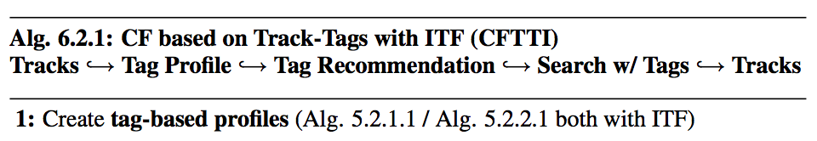
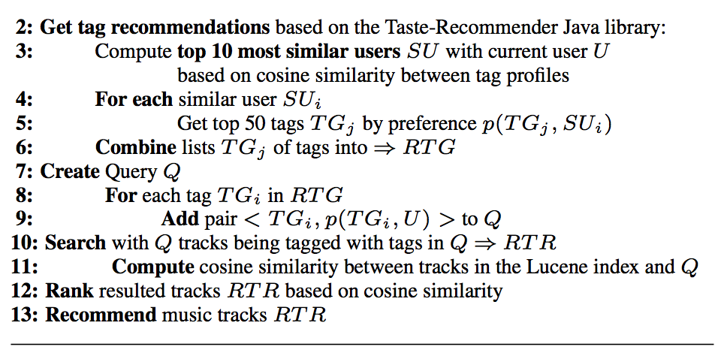
CF based on Track-Tags with ITF (CFTTI)
Claudiu S. Firan, Wolfgang Nejdl, Raluca Paiu, The Benefit of Using Tag-Based Profiles

Slide 87
CF based on Track-Tags No-ITF (CFTTN)
Differs from CFTTI by computing the tag based profiles without the IT F parameter in the formula corresponding to tags’ preference
Claudiu S. Firan, Wolfgang Nejdl, Raluca Paiu, The Benefit of Using Tag-Based Profiles

Slide 88
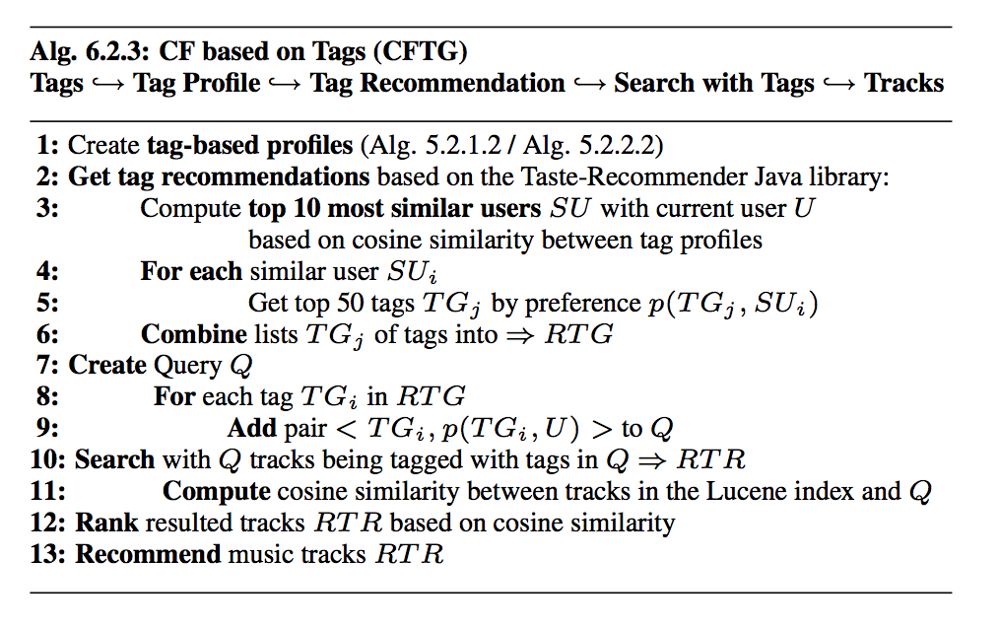
CF based on Tags (CFTG)
Claudiu S. Firan, Wolfgang Nejdl, Raluca Paiu, The Benefit of Using Tag-Based Profiles

Slide 89
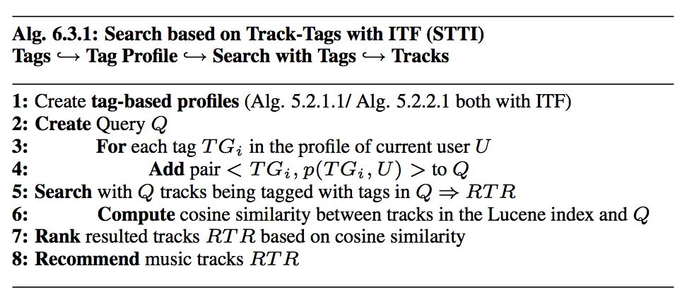
Search based on Track-Tags with ITF (STTI)
Claudiu S. Firan, Wolfgang Nejdl, Raluca Paiu, The Benefit of Using Tag-Based Profiles

Slide 90
Search based on Track-Tags No-ITF (STTN)
Remove the ITF parameter in the preference formula
Claudiu S. Firan, Wolfgang Nejdl, Raluca Paiu, The Benefit of Using Tag-Based Profiles

Slide 91
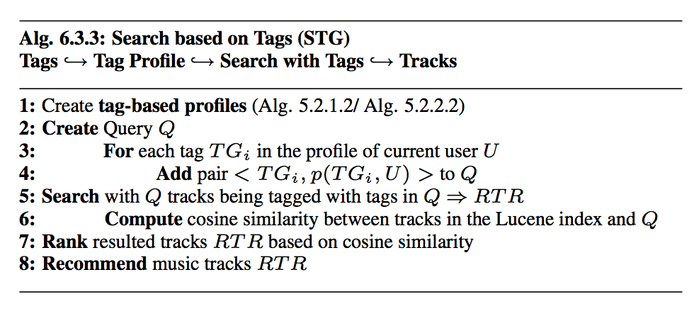
Search based on Tags (STG)
Claudiu S. Firan, Wolfgang Nejdl, Raluca Paiu, The Benefit of Using Tag-Based Profiles

Slide 92
Evaluation
18 subjects: B.Sc., Ph.D., and Post- Doc students in different areas of computer science and education
They installed the desktop application to extract their user profiles, then ran all 7 variants of the described algorithms
For each of the recommended tracks, the users provide two different scores:
how well the recommended track matches their music preferences
the novelty of the track
Claudiu S. Firan, Wolfgang Nejdl, Raluca Paiu, The Benefit of Using Tag-Based Profiles

Slide 93
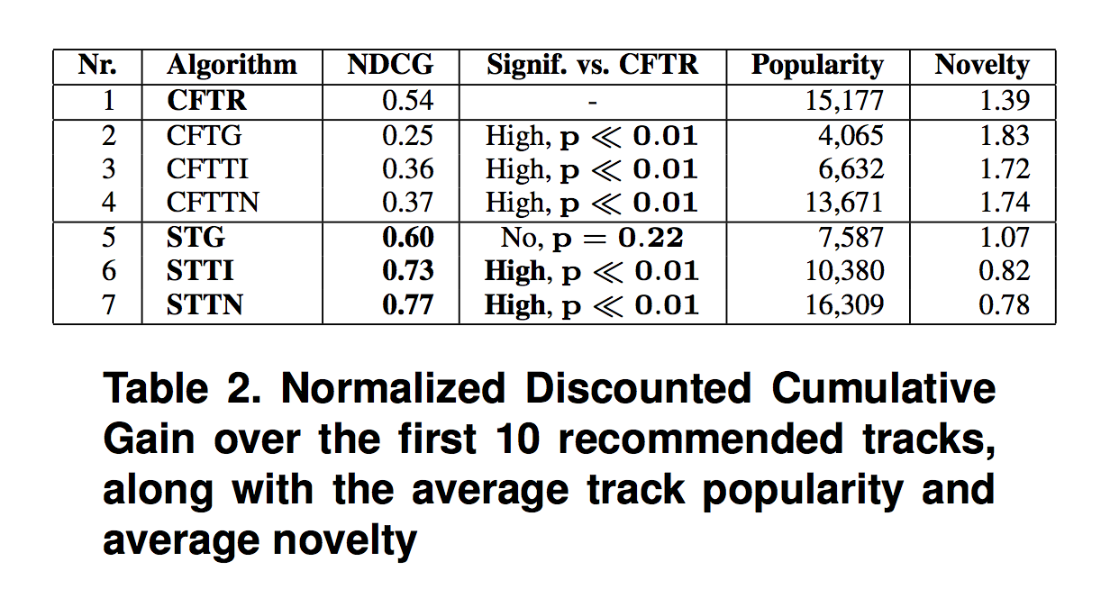
Results
Claudiu S. Firan, Wolfgang Nejdl, Raluca Paiu, The Benefit of Using Tag-Based Profiles

Slide 94
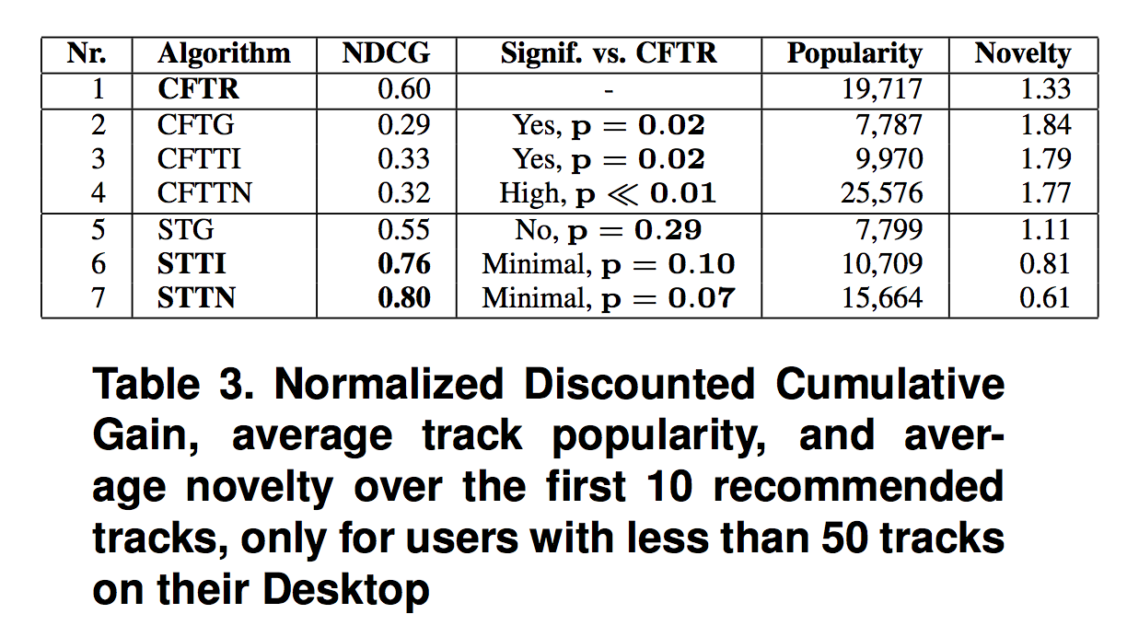
Results
Claudiu S. Firan, Wolfgang Nejdl, Raluca Paiu, The Benefit of Using Tag-Based Profiles

Slide 95
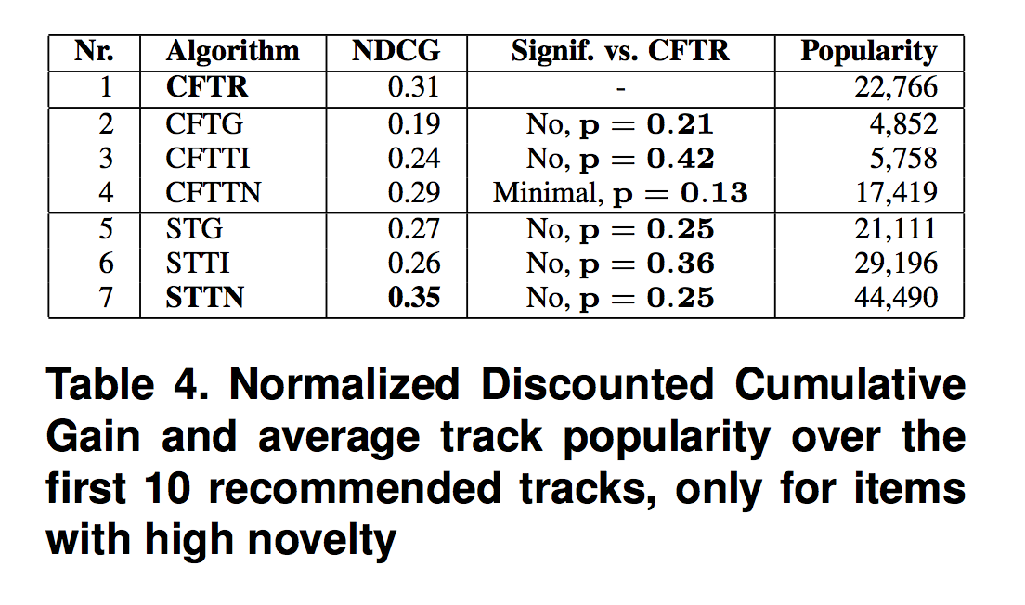
Results
Claudiu S. Firan, Wolfgang Nejdl, Raluca Paiu, The Benefit of Using Tag-Based Profiles

Slide 96
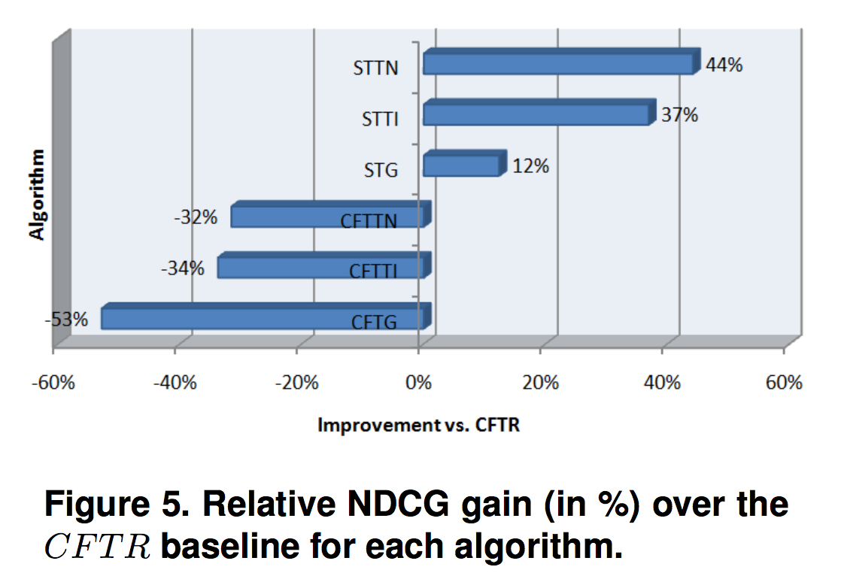
Results
Claudiu S. Firan, Wolfgang Nejdl, Raluca Paiu, The Benefit of Using Tag-Based Profiles

Slide 97
Results
All Collaborative Filtering algorithms based on tags (CFTG, CFTTI, CFTTN) performed worse than the baseline, as standard User-Item CF techniques already show high precision
All search algorithms show quite substantial improvements over track based CF
STG recommends much less popular tracks than our CFTR baseline, but still of higher quality
Claudiu S. Firan, Wolfgang Nejdl, Raluca Paiu, The Benefit of Using Tag-Based Profiles

Slide 98
Results
A first set of algorithms, using collaborative filtering on tag profiles that were extracted from tracks, proved to be less successful than the baseline.
A second set of tag-based search algorithms however improved results’ quality significantly.
In addition to a 44% increase in quality for the best algorithm, search-based methods are also much faster than collaborative filtering and do not suffer from the cold start problem
Claudiu S. Firan, Wolfgang Nejdl, Raluca Paiu, The Benefit of Using Tag-Based Profiles

Slide 99
Harvesting social knowledge from folksonomies
Harris Wu, Mohammad Zubair, Kurt Maly

Slide 100
Motivation
Enhance collaborative tagging systems to meet some key challenges:
community identification
user and document recommendation
ontology generation
Harris Wu, Mohammad Zubair, Kurt Maly, Harvesting social knowledge from folksonomies

Slide 101
Community Identification
Existing community identification techniques:
Spectral: identify all major communities in a large collection
Bibliometrics: determine the pair-wise affinity among users
Network flow based: identify broader communities containing a known existing community
Harris Wu, Mohammad Zubair, Kurt Maly, Harvesting social knowledge from folksonomies

Slide 102
User and Document Recommendation
HITS (Kleinberg 1999) algorithm
Experiment different link weighting mechanisms and combinations with hyperlink analysis to improve the algorithm
Pair-wise similarities between the given document and the rest of the documents
Pair-wise similarities between a given user and the rest of the users
Harris Wu, Mohammad Zubair, Kurt Maly, Harvesting social knowledge from folksonomies

Slide 103
User and Document Recommendation
HITS (Kleinberg 1999) algorithm
Experiment different link weighting mechanisms and combinations with hyperlink analysis to improve the algorithm
Pair-wise similarities between the given document and the rest of the documents
Pair-wise similarities between a given user and the rest of the users
Harris Wu, Mohammad Zubair, Kurt Maly, Harvesting social knowledge from folksonomies

Slide 104
Ontology Generation
An ontology is one of the most efficient structures for navigation
any document can be reached with o(log(n))
Hierarchical clustering problem
Different clustering techniques use different pair-wise similarity measures
Harris Wu, Mohammad Zubair, Kurt Maly, Harvesting social knowledge from folksonomies

Slide 105
Ontology Generation Algorithm
identifies the set of documents for which the hierarchy needs to be generated,
identifies all tags associated with these documents.
constructs a document-tag matrix, denoted by A
A_{ij} = 1 iff document i is tagged by tag j
constructs a tag-tag matrix to store the semantic similarities between tags
Multiplied A by the tag-tag matrix
Each document is now represented by a row vector A_{i}
Harris Wu, Mohammad Zubair, Kurt Maly, Harvesting social knowledge from folksonomies

Slide 106
Evaluation
Offline studies as pre-tests of the design concepts
Collect data through paper-based questionnaires and face-to-face interviews
Use test websites to evaluate selective modules of the proposed design solutions
Use pilot systems to evaluate the proposed design in large knowledge creation environments
Simulate large amounts of user input data to test the scalability
Harris Wu, Mohammad Zubair, Kurt Maly, Harvesting social knowledge from folksonomies

Slide 107
Conclusions
Collaborative tagging systems have the potential of becoming a technological infrastructure for harvesting social knowledge
There are many challenges
The proposed designed prototypes enhance social tagging systems to meet some of the key challenges
Preliminary results show promise
Harris Wu, Mohammad Zubair, Kurt Maly, Harvesting social knowledge from folksonomies

Slide 108
Tutorial Conclusions

Slide 109
Recap
Recommender systems are widely used in the web
Facebook, Amazon, Netflix, …
There are many different recommender algorithms
Tradition recommender algorithms has pros and cons
Hybrid approaches combines multiple recommender algorithms
User profile is useful for personalized recommendations
Leveraging Tagging Systems with User Information can improve results

Slide 110
Take-Aways
Shared tags can improve resource discovery
Using quadratic concepts of users, tags, resources and profiles maximize sets of users sharing resources with the same tags. They can be used to find a personalized choice of tags and resources when suggestions are made following the users’ profiles
Hybrid tagging recommender system can cover more dimensions of the data by different components
Using tag-based search algorithms can significantly improve the quality of results
Collaborative tagging systems have many challenges, but can be enhanced by using with other components

Slide 111
Future Works
Current project at work:
There are a lot of files coming into the enterprise file distribution system daily
Files are tagged “automatically” based on file name and a set of predefined rules
Users subscribe to particular files based on predefined subscriptions
Problems:
File name contains file metadata, so it must be a certain format
Difficult to manually manage all predefined rules and subscriptions
Some files might be useful for analysts, but they didn’t subscribe

Slide 112
Future Works
Implement algorithm to automatically suggest tags to a file
Implement algorithm to recommend public files to user based on their roles and interests

Slide 113
Acknowledgements
Daniar Asanov, Algortihms and Methods in Recommender Systems, 2011
Robin Burke, Hybrid Recommender Systems: Survey and Experiments, User Modeling and User-Adapted Interaction, v.12 n.4, p.331-370, November 2002
Mohamed Nader Jelassi, Sadok Ben Yahia, Engelbert Mephu Ngui, A Personalized Recommender System Based on Users’ Information In Folksonomies, Proceedings of the 22nd International Conference on World Wide Web, May 2013
Kerstin Bischoff , Claudiu S. Firan , Wolfgang Nejdl , Raluca Paiu, Can all tags be used for search?, Proceedings of the 17th ACM conference on Information and knowledge management, October 26-30, 2008, Napa Valley, California, USA
Jonathan Gemmell , Thomas Schimoler , Bamshad Mobasher , Robin Burke, Hybrid tag recommendation for social annotation systems, Proceedings of the 19th ACM international conference on Information and knowledge management, October 26-30, 2010, Toronto, ON, Canada

Slide 114
Acknowledgements
Harris Wu , Mohammad Zubair , Kurt Maly, Harvesting social knowledge from folksonomies, Proceedings of the seventeenth conference on Hypertext and hypermedia, August 22-25, 2006, Odense, Denmark
Hao Ma , Dengyong Zhou , Chao Liu , Michael R. Lyu , Irwin King, Recommender systems with social regularization, Proceedings of the fourth ACM international conference on Web search and data mining, February 09-12, 2011, Hong Kong, China
Philip Bonhard , Clare Harries , John McCarthy , M. Angela Sasse, Accounting for taste: using profile similarity to improve recommender systems, Proceedings of the SIGCHI Conference on Human Factors in Computing Systems, April 22-27, 2006, Montréal, Québec, Canada
Claudiu S. Firan , Wolfgang Nejdl , Raluca Paiu, The Benefit of Using Tag-Based Profiles, Proceedings of the 2007 Latin American Web Conference, p.32-41, October 31-November 02, 2007
Mohsen Jamali , Martin Ester, A matrix factorization technique with trust propagation for recommendation in social networks, Proceedings of the fourth ACM conference on Recommender systems, September 26-30, 2010, Barcelona, Spain

Slide 115
Thanks! Questions?

